Slide 1

Codeflix Churn Analysis
Learn SQL from Scratch
Jenna Edward – June 05 2018 Cohort

Slide 2
Table of Contents
Capstone Project Objectives
1. Get familiar with the company.
How many months has the company been operating? Which months do you have enough information to calculate a churn rate?
What segments of users exist?
2. What is the overall churn trend since the company started?
3. Compare the churn rates between user segments.
Which segment of users should the company focus on expanding?
Codeflix overview slides 3 – 5
Overall churn rate slides 6 – 7
Churn rate by segment slides 8 – 10
Appendix slides 11 – 12

Slide 3
1. Codeflix overview

Slide 4
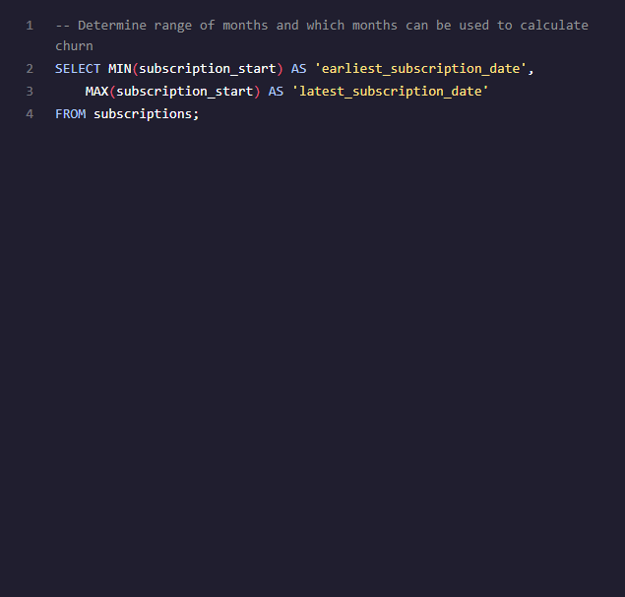
1.1 Duration Codeflix has been in operation and months which can be used to calculate churn
Codeflix has been operational from December 2016 to March 2017 (4 months).
Codeflix subscribers must remain active for a minimum of 31 days so none of the subscribers who joined in December could leave within that month. Therefore, the months which can be used to calculate churn are January, February and March of 2017.
earliest_subscription_date | latest_subscription_date
2016-12-01 | 2017-03-30

Slide 5
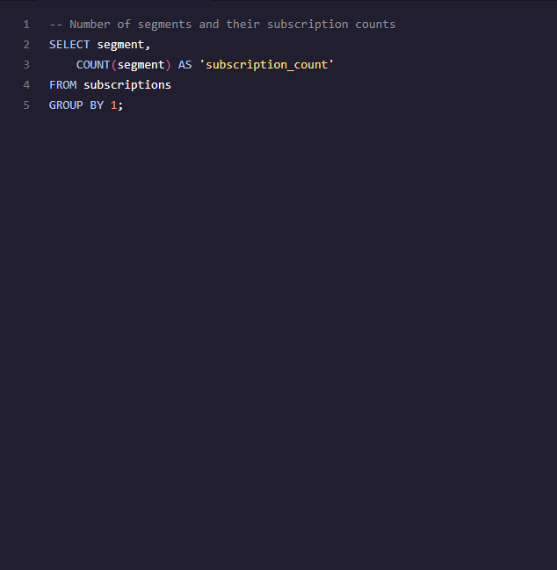
1.2 Codeflix user segments
Codeflix has 2 user segments, they are 30 and 87
Each user segment has records for 1000 subscribers
segment | subscription_count
30 | 1000
87 | 1000

Slide 6
2. Overall churn rate

Slide 7
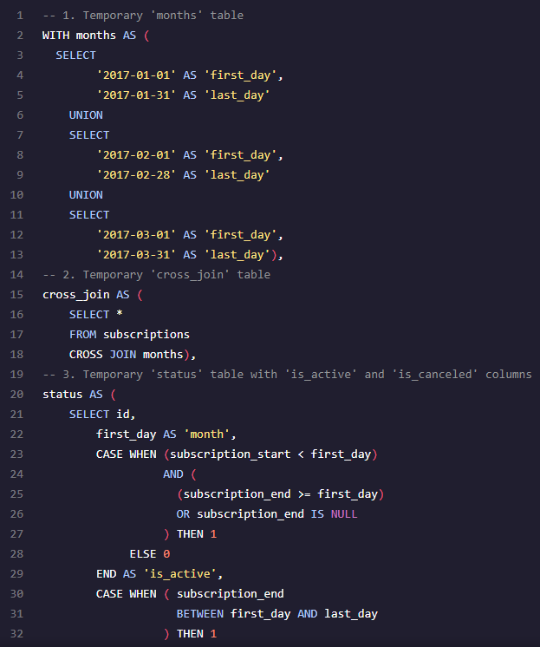
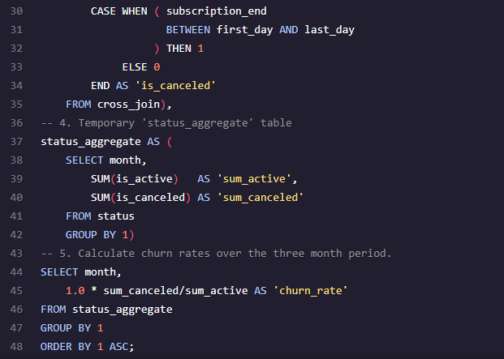
2.1 Overall Churn Rate
The overall churn rate for Codeflix is increasing each month.
January churn rate was 16.14% and by March the churn rate has increased by 11.2 percentage points (a 68.3% increase).
month | churn_rate
01/01/2017 | 16.14%
01/02/2017 | 18.88%
01/03/2017 | 27.16%

Slide 8
3. Churn rate by segment

Slide 9
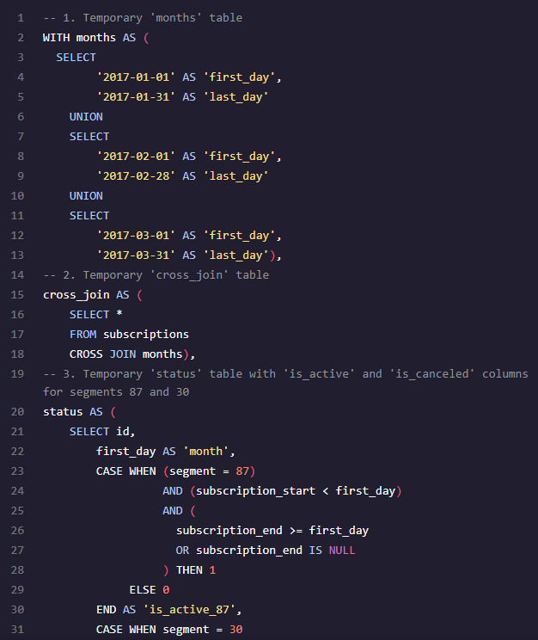
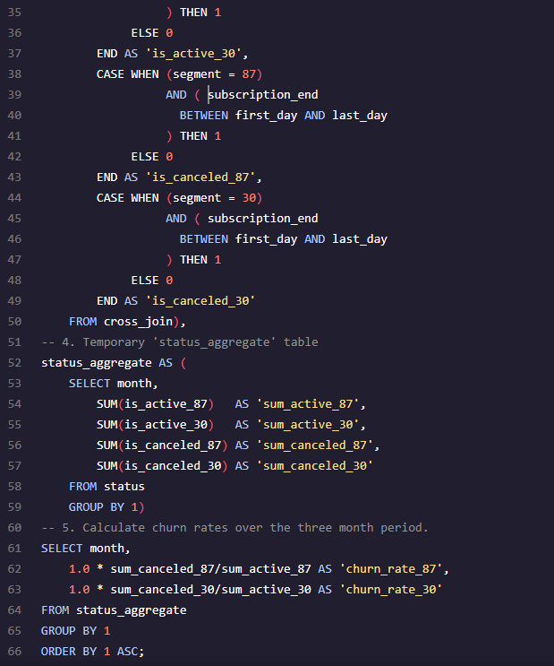
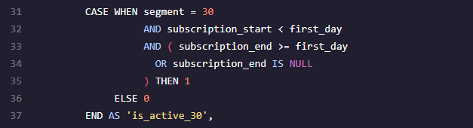
3.1 Churn rate by Segment
The churn rates by segment for Codeflix are very different.
Segment 87 is on average 3.9 times higher than segment 30
Segment 87 churn rate has also continuously increased across the 3 month period, whereas segment 30 decreased slightly in February 2017 before increasing in March.
month | churn_rate_87 | churn_rate_30
01/01/2017 | 25.09% | 7.56%
01/02/2017 | 31.69% | 7.34%
01/03/2017 | 47.69% | 11.70%

Slide 10
3.2 Conclusion
Codeflix should focus on expanding segment 30 because:
The churn rate for this segment is significantly lower than segment 87.
Segment 30 shows potential to be able to maintain a stable rate of churn from month to month, whereas segment 87 has only displayed a trend of increasing churn.

Slide 11
4. Appendix
Bonus question:
How can the code be modified to support a large number of segments?

Slide 12
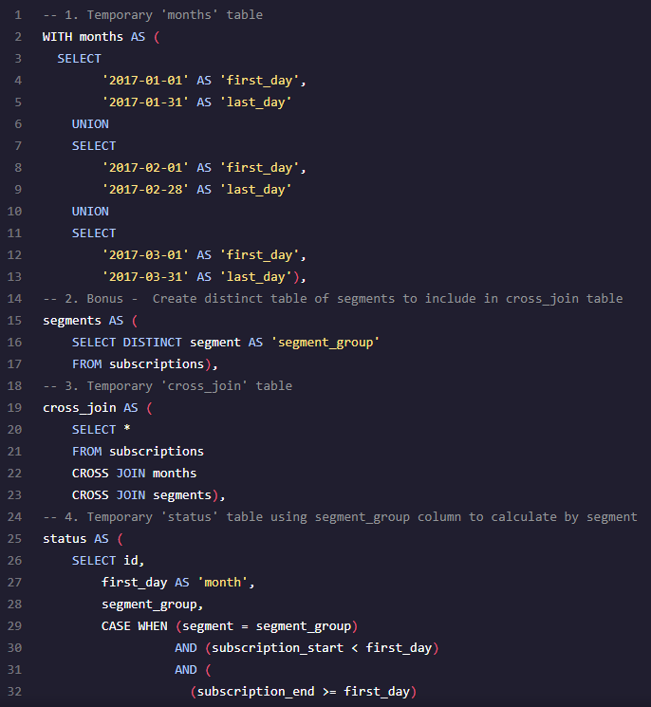
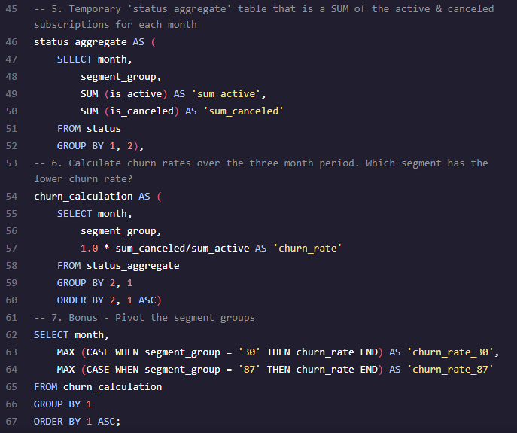
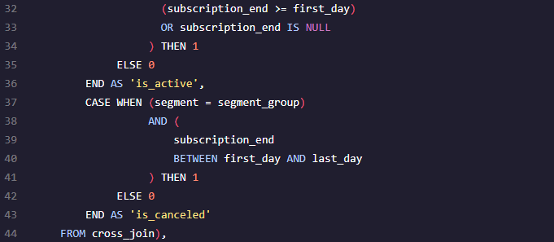
4.1 Query variant to support large number of segments
As Codeflix expands the number of user segments it offers in the future, the query should be modified to minimize the amount of segment hardcoding, thereby reducing the time required to add new segments to existing reporting.
The modification includes an extra temporary table for determining the distinct user segments, which is cross joined to ‘subscriptions’ (in addition to ‘month’)
The ‘status’ table can then dynamically calculate active and canceled statuses for each segment using the ‘segment_group’ column.
The ‘status_aggregate’ and ‘churn_calculation’ tables are now simplified as they don’t need to have the calculations written for each segment column.
A final table is added to pivot the results into separate columns for each segment (this is optional, as it may be quicker to export the ‘churn_calculation’ table and pivot in excel)

